Slide 1
If I were the mayor of Karlovac…
[student name, class]

Slide 2
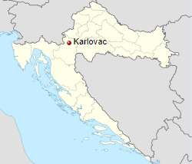
Location of Karlovac
Karlovac is located in central Croatia between the Croatian lowlands, Croatian highlands, Pokupje and Kordun
it is framed by four rivers - Kupa, Korana, Dobra and Mrežnica
it is only 50 kilometres away from Slovenia and from Bosnia and Herzegovina and as such has an important traffic and economic significance

Slide 3
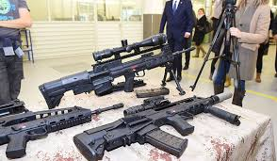
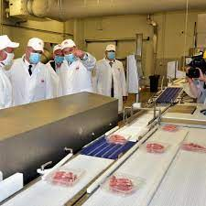
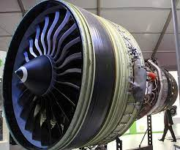
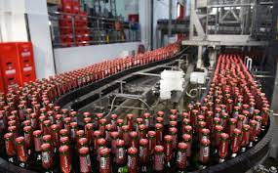
Karlovac industry
the economy of Karlovac mainly relies on a handful of privately owned companies such as:
  HS Produkt (gun industry)
  PPK (meat industry)
  Heineken (beer industry)
  General Electric (machining industry)

Slide 4
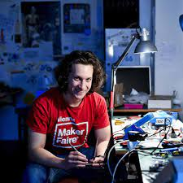
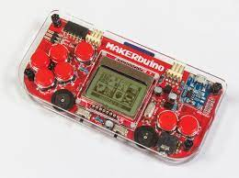
Innovators in Karlovac
fortunately, Karlovac does not suffer from a lack of young people with vision, the most famous one being Albert Gajšak, the owner of the CircuitMess startup
some of his most successful inventions include the MAKERbuino gaming console and the Batmobile racing car for kids

Slide 5
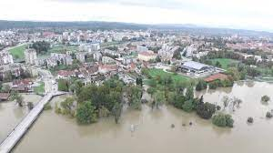
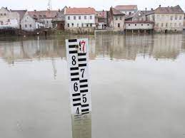
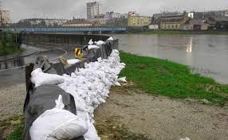
The effects of climate change in Karlovac
since Karlovac is situated near four different rivers, the biggest threat to the city itself are occasional floods
it is imperative that we build river defenses such as embankments along the most endangered areas of Mrežnica and Korana rivers

Slide 6
5G mobile network in Karlovac
Croatian ISPs are well on their way to building a robust 5G mobile network
the latest generation allows an easier access to the Internet, a greater number of connected devices and a more reliable communication with very little latency

Slide 7
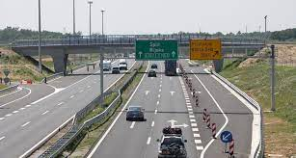
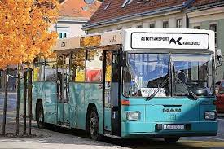
What Karlovac still needs
even though almost every major mode of transportation runs through Karlovac, there is still room for improvement
more frequent bus and train lines are needed, especially ones connecting rural areas with the city center

Slide 8
Quiz time!
(hopefully, you’ve been paying attention)

Slide 9

WRONG!
I’m sorry, that’s incorrect. Go back and try a different answer!

Slide 10
Question #1
Where is Karlovac located:
Central Croatia
Dalmatia
Istria
Slavonia

Slide 11

CORRECT!
You have answered correctly! Well done!

Slide 12
Question #2
Odd man out! Which of these companies is NOT located in Karlovac?
General Electric
Heineken
HS Produkt
PPK
Rimac Automobili

Slide 13
CORRECT!
You have answered correctly! Well done!

Slide 14
Question #3
What did Albert Gajšak invent?
solar panels
MAKERbuino gaming console
a new type of engine
NASA Mars rover

Slide 15
CORRECT!
You have answered correctly! Well done!

Slide 16
Question #4
What is the biggest danger to Karlovac in autumn?
earthquakes
droughts
floods
wildfires

Slide 17
CORRECT!
You have answered correctly! Well done!

Slide 18
Question #5
What is the typical download speed for a 5G mobile network?
<0.1 Mbit/s
4 Mbit/s
30 Mbit/s
150 Mbit/s

Slide 19
CORRECT!
You have answered correctly! Well done!

Slide 20
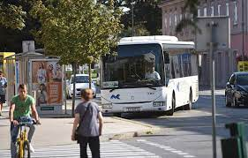
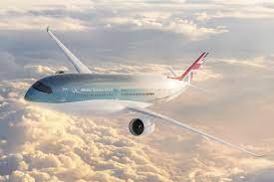
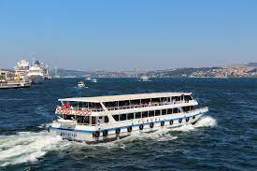
Question #6
What type of transport could Karlovac use more of?

Slide 21
CORRECT!
You have answered correctly! Well done!

Slide 22
You’re all done!
Congratulations!

Slide 23
Sources
www.karlovac.hr
www.tportal.hr
www.glasistre.hr
www.hakom.hr
www.kenstechtips.com

