Slide 1
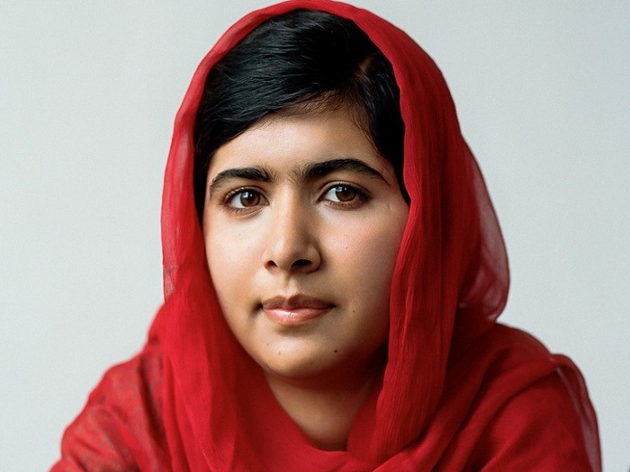
Malala Yousafzai

Slide 2
Who is Malala Yousafzai?
Malala Yousafzai was born on July 12, 1997. Yousafzai was born in Mingora, Pakistan. Malala is a women's education activist and the youngest Nobel laureate. Her great inspiration were the thoughts of her father and the humanitarian work.

Slide 3
She is known for advocating for human rights, especially the education of women and children in her native Pakistan, where the local Taliban have at times barred girls from attending school. In early 2009, when she was 11-12 years old, she wrote a blog under a pseudonym describing life during the Taliban occupation. The following summer, a journalist made a New York Times documentary about her life as the Pakistani military intervened in the region.
On October 10, 2012, the Taliban tried to take her life because she bravely opposed them, as well as their intentions to ban women from accessing education. She survived a bullet in the head, which was fired by a masked Taliban to punish her for criticizing the Taliban regime on her blog, which forbids women from going to school. She was recovering after more than three months.

Slide 4
The world was shocked by the attempted brutal murder, and because of her courage, in 2014 she won the Nobel Peace Prize. Although she was very young, Malala was an example that children and young people can contribute to improving their own situation.
She was not discouraged by the assassination and continued to speak out about the importance of education. At no point did she think of giving up her activist engagement.
"The terrorists thought that they would change our goals and stop our ambitions, but nothing has changed in my life, except that weakness, fear and hopelessness have died. Even if I held a weapon and he was in front of me, I would not shoot him," she said in a speech to the UN.

Slide 5
SOME OF HER INSPIRING QUOTES
One child, one teacher, one pen, and one book can change the world.
I raise up my voice - not so I can shout but so that those without a voice can be heard. We cannot succeed when half of us are held back.
If one man can destroy everything, why can't one girl change it?
When the whole world is silent, even one voice becomes powerful.
With guns you can kill terrorists, With education you can kill terrorism.”
Education is neither Eastern nor Western, it is human.
When someone takes away your pens you realise quite how important education is.

